Slide 1
HEAT FLUXES ACROSS THE ACC AT UDINTSEV FRACTURE ZONE
D. Randolph Watts and Kathleen Donohue
University of Rhode Island
Southern Ocean heat budget
Drake Passage results
Amundsen project plans

Slide 2
ACC path and SSH standard deviation (m)
- global stationary meander; SAF, PF, SACCF
- eddy variability indicates poleward heat flux

Slide 3
Southern Ocean Heat Budget
Ekman + MOC
0.9PW, 45S
0.4PW, 55S
0.1PW, 58S
Heat loss to atmosphere
~ 0.5 PW south of 60S
These two must be compensated by eddy and mean heat transport, ~ -0.6 to -0.9 PW in northern ACC,
decreasing in southern ACC

Slide 4
Southern Ocean Heat Budget
UFZ
PIG
Heat crosses the ACC at Udintsev Fracture Zone and advects along southern ACC toward Amundsen Sea

Slide 5
Southern Ocean Heat Budget
UFZ
Drake Passage
study site
PIG
Heat crosses the ACC at Udintsev Fracture Zone and advects along southern ACC toward Amundsen Sea

Slide 6
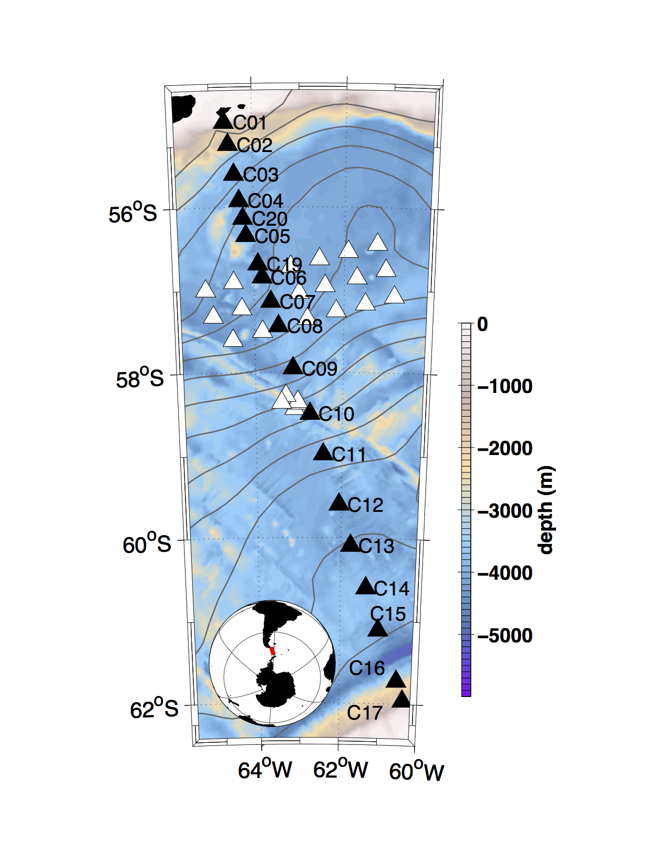
“cDrake” -- Drake Passage
Dynamics and Transport of the ACC
Local dynamics array: daily fields (u,v) T, ρ, mesoscale resolution; eddy heat and buoyancy fluxes.
Transport line: 800 km,
time-varying structure.
, = CPIES
4 years,12/2007- 12/2011
co-PI’s: T. Chereskin,
K. Donohue, R. Watts
funded by US NSF grants ANT-0635437 and ANT-0636493.

Slide 7
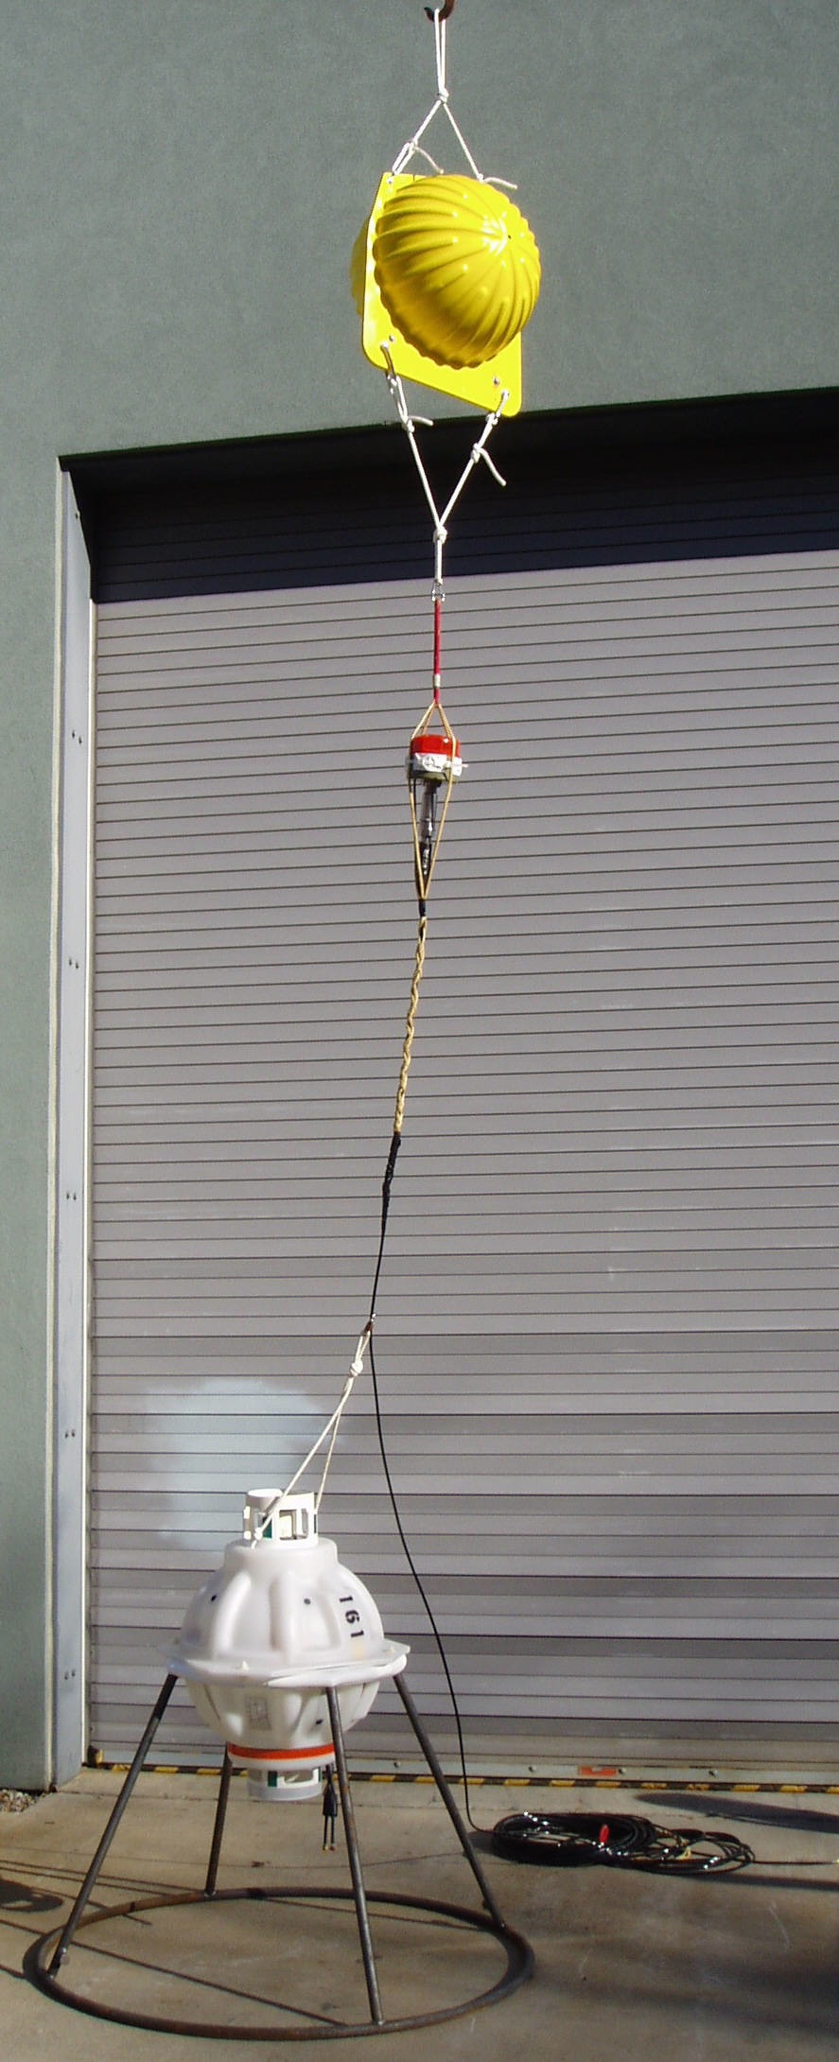
CPIES:
current and pressure recording inverted echo sounder
Measures currents 50 m off bottom.
Measures round trip travel times of acoustic pulses from bottom to surface.
Measures bottom pressure.
CPIES array yields daily maps of current and temperature and buoyancy fields
u(x,y,p,t), T(x,y,p,t), b(x,y,p,t)
Donohue et al. (2010 JTech);
Firing et al. (2014 JTech, in press)

Slide 8
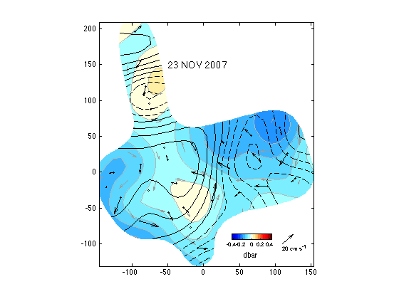
Upper shear stream function (contour lines) and
Bottom pressure stream function (colors) and current vectors

Slide 9
Now view animations / movies of ACC in Local Dynamics Array

Slide 10
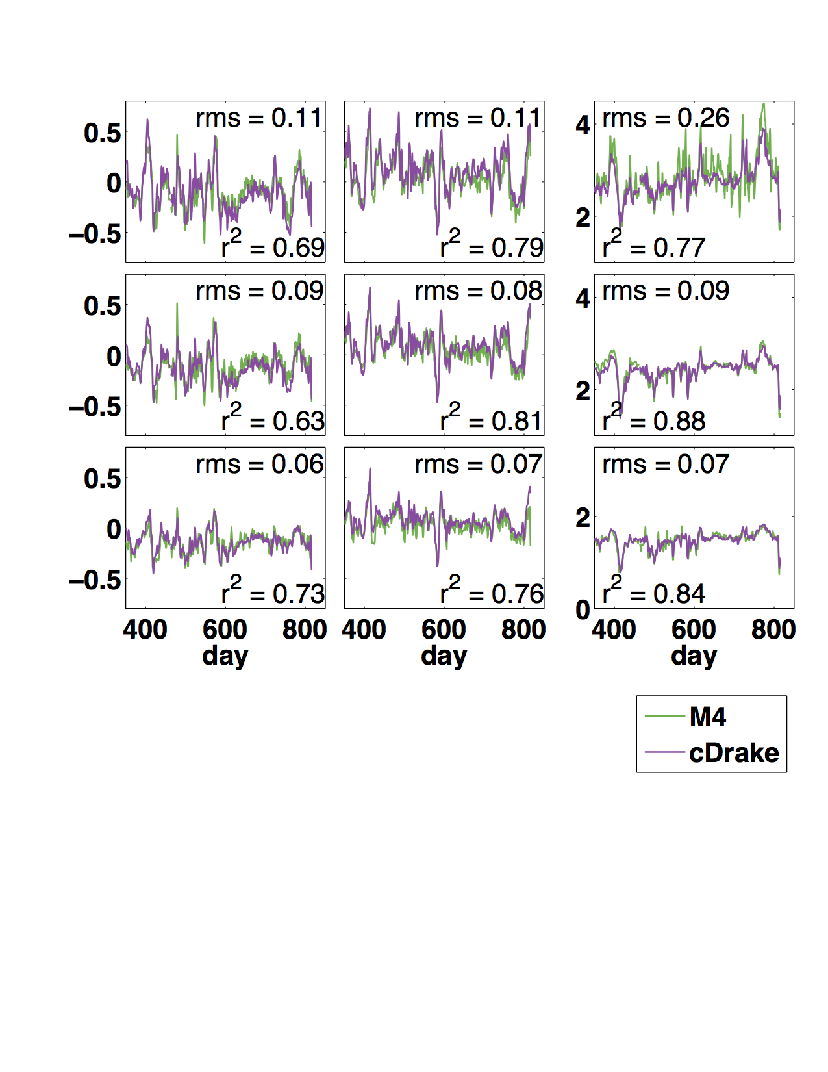
(u, v) and T are estimated well, top to bottom e.g, comparison with French mooring (thanks to C.Provost)
u (m/s)
v (m/s)
T (°C)
520 dbar
1020 dbar
2540 dbar
Y. Firing et al., 2014 JTech., in press

Slide 11
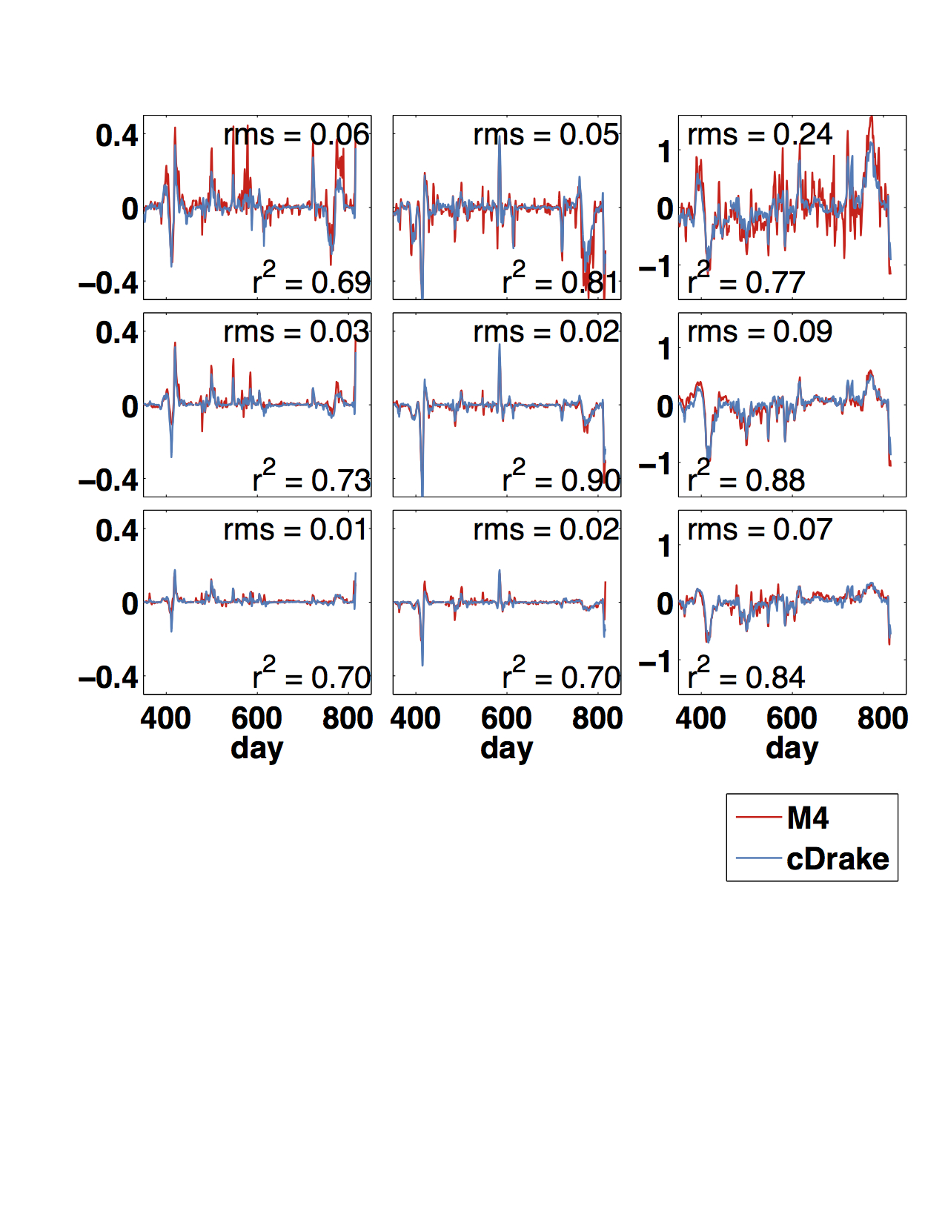
(u’T’, v’T’) are also estimated well, top to bottom again by comparison with French mooring (thanks to C.Provost)
u’T’ (°C m/s)
v’T’ (°C m/s)
T’ (°C)
520 dbar
1020 dbar
2540 dbar
➔ CPIES measure eddy heat flux well.

Slide 12
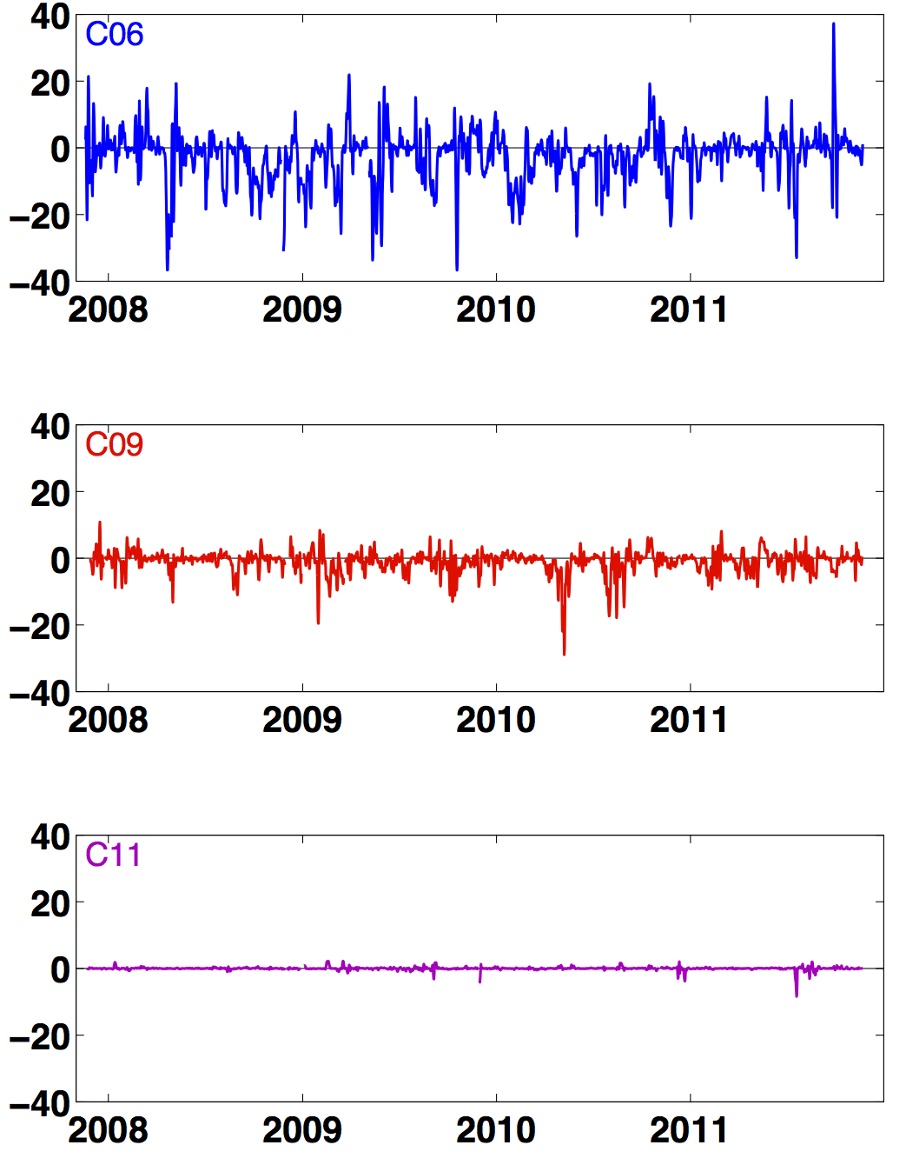
Eddy heat fluxes at representative sites, 400 m
v’_{ref}T’ (°C cm/s)
Intense poleward fluxes in SAF/PF interfrontal zone;
(BC instability)
In PF, mean EHF grows in strong poleward pulses, downstream of Shackleton Fracture Zone
Weak heat flux events upstream of SFZ
Mean <v’_{ref}T’> stable in 2 years

Slide 13
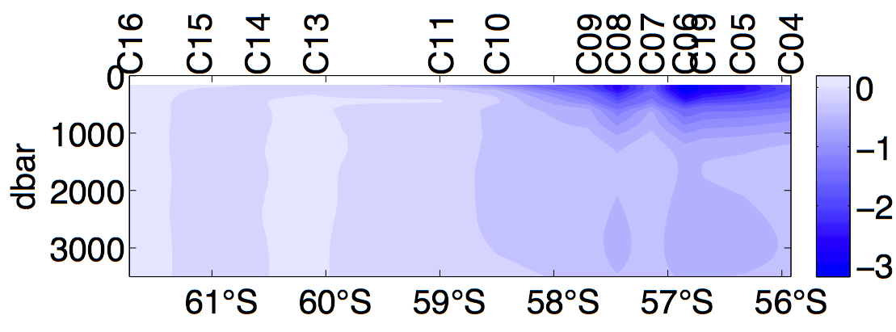
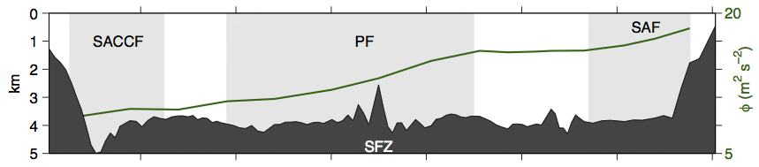
4-year Mean Eddy Heat Flux on 800 km Transect
Poleward mean flux ~ 1.8(°C cm/s) in north in lee of SFZ;
~ 2.5(°C cm/s) at 400 m in zone between SAF and PF.
Weaker by factor of ~ 8 in southern portion.
<v’_{ref}T’> (°C cm/s)
φ
geopotential
Depth

Slide 14
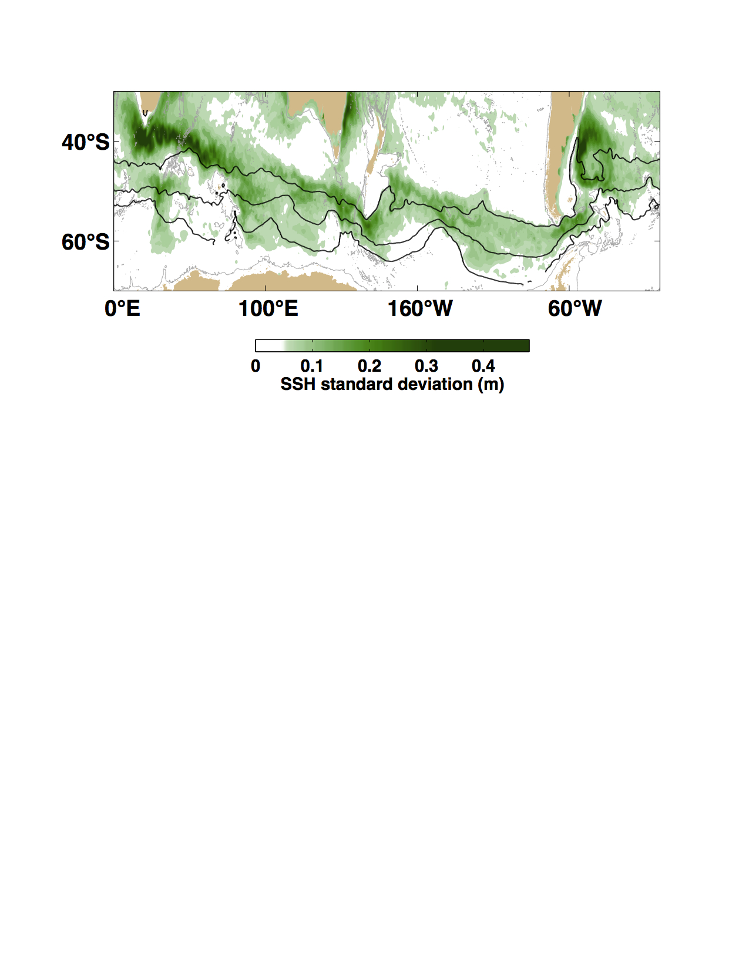
Summary 1. Eddy Heat Flux – global context
Compare to air-sea heat loss ~0.6 PW, south of 60°S.
In SAF -- assume zonal average ~ 2 PW poleward eddy flux
In southern ACC -- … 0.2 PW “ “ “

Slide 15
ACC_UFZ heat fluxes join with a team of French and Korean scientists from LOCEAN and KOPRI/KIOST
UFZ
PIG
Overall Goal: Quantify fluxes of heat, buoyancy, momentum, and PV across the whole ACC

Slide 16
Udintsev Fracture Zone – work plan
Northern array of 6 CPIES in lee of UFZ with max SSH_{std} between SAF and PF.
Southern array of 3 CPIES downstream of SACCF crossing Pacific AA Ridge.
SSH_{std} is high there for southern ACC (1/3 of northern array, and 3X southern Drake)

Slide 18
Thank you for your attention
– QUESTIONS?

Slide 19
The 20th International Symposium on Polar Sciences (ISPS)
KOPRI, Incheon, Republic of Korea, May 27-29, 2014
CROSS-FRONTAL FLUXES IN THE ACC NEAR UDINTSEV FRACTURE ZONE
D. Randolph Watts and Kathleen Donohue
University of Rhode Island
Across the Antarctic Circumpolar Current (ACC), fluxes of heat and momentum and other dynamical quantities establish the heat budget for the whole Southern Ocean, govern the strength of the ACC and its vital inter-ocean exchanges, and arguably govern the main pycnocline structure of the world oceans. Heat that melts glaciers along the Antarctic coast must have first crossed the ACC by a combination of mean and eddy heat transport mechanisms. The Udintsev Fracture Zone, northwest of the Amundsen study region and Pine Island Glacier, is a local “hot spot” of eddy activity in the lee of the ACC crossing the Pacific Antarctic Ridge. It is hypothesized that large southward mean and eddy heat transport occurs in that region. A particular question is how the relatively large eddy heat fluxes that occur along the northern ACC (SAF and PF) continue to cross further southward across the southern ACC (SACCF).
This study will deploy two arrays of Current and Pressure recording Inverted Echo Sounders (CPIES), for a period of 2 years, in order to observe and quantify exchanges of heat and dynamical quantities across the ACC. The methods and results will be described from a CPIES array in Drake Passage. The array locations near the Udintsev Fracture Zone (UFZ) have been selected because the SAF, PF, and SACCF converge closely together as they deflect equatorward where they encounter complex shallower ridges and exhibit strong eddy variability in the lee. Therefore, the UFZ emerges as a likely location for mean and eddy fluxes to conspire to cross the entire ACC enroute southward, ultimately affecting the Antarctic coast. This will be a collaborative study with a team of French and Korean scientists, who have been granted separate funding to deploy tall current meter moorings and conduct CTD surveys in this location. The French and Korean tall moorings will provide measurements of currents and temperature at fixed levels, providing complementary estimates of mean and eddy fluxes.

